Slide 1





A short Briefing on Banking Analytics

Slide 2

Bank Analytics & Dashboard
Analytics for Stake-Holders
01
Bank Loan Dashboard
06
02
05
Bank Debit And Credit Dashboard
04
03

Slide 3
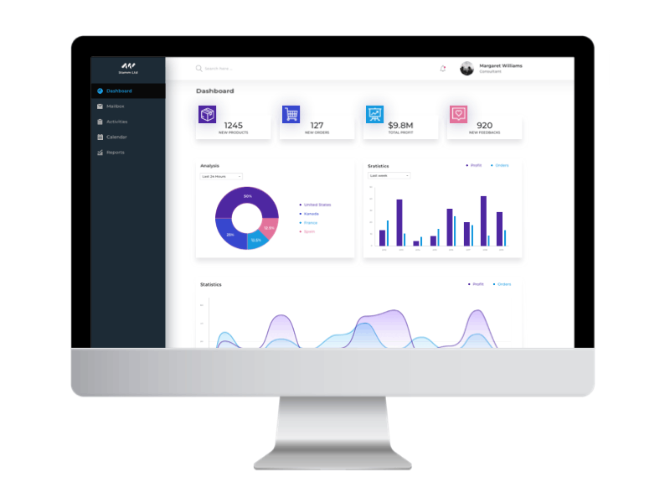
Project Steps for Banking Data Analysis
Tools Used: Excel, Tableau, Power BI, MY SQL.
Step-by-Step Workflow:
  Excel Dashboard: Create an initial dashboard using provided Excel data.
  SQL Integration: Load files into a SQL database under a banking data schema.
  BI Tool Connection: Connect SQL database to Tableau/Power BI and create a data model with necessary joins.
  Dashboard Development: Build interactive dashboards in Tableau and Power BI.
  Quality Assurance (QA): Validate data by comparing database records with dashboards to ensure accuracy.
  Final Presentation : Create Final Presentation and Present with PPT order
  1-Group Details
  2-Summary about the Project
  3-KPI List
  4-Excel Dashboard
  5-Tableau Dashboard
  6-Power BI Dashboard
  7-SQL Query Image
  8-Key Takeaway

Slide 4
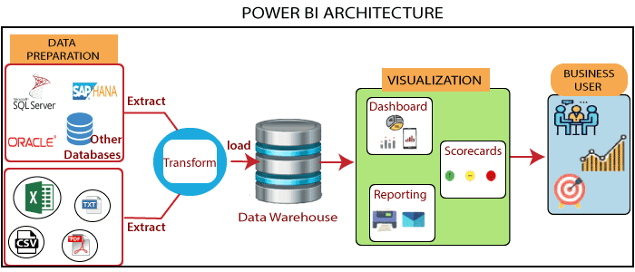

Slide 5
Bank Analytics & Dashboard
Analytics for Stake-Holders
Loan Dashboard KPI Description
Total Loan Amount Funded: Measures the total value of loans disbursed.
Total Loans: Tracks the number of loans issued.
Total Collection: Reflects repayment performance, including principal and interest.
Total Interest: Captures revenue from loan interest.
Branch-Wise Performance: Analyzes revenue (interest, fees, total) by branch.
State-Wise Loan: Shows geographic distribution of loans.
Religion-Wise Loan: Monitors loan distribution across religious demographics.
Product Group-Wise Loan: Categorizes loans by product types (e.g., personal, auto).
Disbursement Trend: Tracks changes in loan disbursements over time.
Grade-Wise Loan: Assesses portfolio risk by borrower credit grades.
Default Loan Count: Counts loans in default.
Delinquent Client Count: Tracks borrowers with missed payments.
Delinquent Loan Rate: Percentage of loans overdue in the portfolio.
Default Loan Rate: Proportion of defaulted loans to the total portfolio.
Loan Status-Wise Loan: Breaks down loans by status (active, delinquent, closed).
Age Group-Wise Loan: Categorizes loans by borrowers’ age groups.
Loan Maturity: Tracks the timeline until full repayment
No Verified Loans: Identifies loans without proper verification.

Slide 6
1. Total Loan Amount Funded
Definition: The total monetary value of all loans disbursed to clients.
Purpose: Indicates the bank's lending capacity and market outreach.
2. Total Loans
Definition: The total number of loans issued, including active and closed loans.
Purpose: Measures the scale of lending activities.
3. Total Collection
Definition: The total amount collected from borrowers, including principal and interest.
Purpose: Tracks repayment performance and cash flow generation.
4. Total Interest
Definition: The total revenue generated from interest on loans.
Purpose: Reflects the profitability of the bank's lending operations.
5. Branch-Wise (Interest, Fees, Total Revenue)
Definition: Revenue breakdown by branch, including interest income, fees, and combined revenue.
Purpose: Assesses the performance of individual branches.
6. State-Wise Loan
Definition: Distribution of loans across different states.
Purpose: Analyzes geographic trends in lending.
7. Religion-Wise Loan
Definition: Loan distribution categorized by clients’ religious demographics.
Purpose: Ensures compliance with any diversity or inclusion policies.
8. Product Group-Wise Loan
Definition: Loan categorization by product types, e.g., personal, mortgage, or auto loans.
Purpose: Identifies product performance and trends.
9. Disbursement Trend
Definition: Historical trend of loan disbursements over time.
Purpose: Tracks growth or decline in lending activities.

Slide 7
8-Transaction Volume by Bank:
Formula: Sum of the Amount column grouped by Bank Name.
Insight: Helps compare the performance of different banks in terms of transaction activity.
9-Transaction Method Distribution:
Formula: Count or percentage of transactions grouped by Transaction Method (Bank Transfer, Debit Card, Credit Card, etc.).
Insight: Shows which transaction methods are most popular, helping to optimize service offerings.
10-Branch Transaction Growth:
Formula: Percentage change in the total transaction amount or volume at each branch over a defined period.
Insight: Identifies whether a particular branch is growing or declining in terms of transaction volume.
11-High-Risk Transaction Flag:
Formula: Flag transactions that exceed a predefined amount or show irregular activity (e.g., large withdrawals or deposits).
Insight: Helps to identify potentially fraudulent transactions that need further investigation.
12-Suspicious Transaction Frequency:
Formula: Count of flagged high-risk transactions over a period.
Insight: Measures the frequency of potentially suspicious transactions.

Slide 8
10. Grade-Wise Loan
Definition: Classification of loans based on borrower credit grades.
Purpose: Measures the risk profile of the loan portfolio.
11. Count of Default Loan
Definition: Total number of loans that have defaulted.
Purpose: Highlights credit risk and loss exposure.
12. Count of Delinquent Clients
Definition: Number of clients who have missed payments or are overdue.
Purpose: Monitors early signs of repayment challenges.
13. Delinquent Loans Rate
Definition: Percentage of loans in delinquency status compared to the total loan portfolio.
Purpose: Assesses the overall quality of the loan book.
14. Default Loan Rate
Definition: Percentage of defaulted loans relative to the total loan portfolio.
Purpose: Evaluates long-term risk and loss potential.
15. Loan Status-Wise Loan
Definition: Distribution of loans based on their current status (active, closed, delinquent, defaulted).
Purpose: Provides a comprehensive overview of the portfolio's health.
16. Age Group-Wise Loan
Definition: Loan allocation segmented by borrowers’ age groups.
Purpose: Analyzes customer demographics and lending patterns.
17. No Verified Loan
Definition: Number of loans issued without full verification or documentation.
Purpose: Identifies compliance gaps or risky lending practices.
18. Loan Maturity
Definition: The duration until loans are fully repaid.
Purpose: Assesses the structure and timeline of the loan portfolio.

Slide 9
Bank Debit and Credit Dashboard KPI Description
1-Total Credit Amount:
Formula: Sum of the Amount column where Transaction Type = "Credit".
Insight: Measures the total amount of deposits or credits, which can be compared against total withdrawals.
2-Total Debit Amount:
Formula: Sum of the Amount column where Transaction Type = "Debit".
Insight: Measures the total amount of withdrawals or debits.
3-Credit to Debit Ratio:
Formula: Total Credit Amount ÷ Total Debit Amount.
Insight: Shows the ratio of credits to debits, which helps to understand whether the bank is receiving more deposits than withdrawals.
4-Net Transaction Amount:
Formula: Total Credit Amount - Total Debit Amount.
Insight: Measures the net cash flow (positive or negative) for the bank over a period.
5-Account Activity Ratio:
Formula: Number of transactions ÷ Account balance.
Insight: Indicates how active a customer is in relation to their balance.
6-Transactions per Day/Week/Month:
Formula: Number of transactions occurring per day, week, or month.
Insight: Identifies transaction volume trends over time, helping to detect periods of high or low activity.
7-Total Transaction Amount by Branch:
Formula: Sum of the Amount column grouped by Branch.
Insight: Measures the total transaction volume per branch, helping to compare branch performance.
Transaction Volume by Bank:

Slide 10
Project Roadmap
Date | Time | Task Description
10-10-2025 | 4:45 PM | Project Kick-off Meeting
17-10-2025 | 4:45 PM | Implementation of KPI’s using Excel
24-10-2025 | 4:45 PM | Implementation of KPI’s using Tableau - SQL
31-10-2025 | 4:45 PM | Implementation of KPI’s using Power BI– SQL
07-11-2025 | 4:45 PM | Final Presentation of the Project

